Slide 1
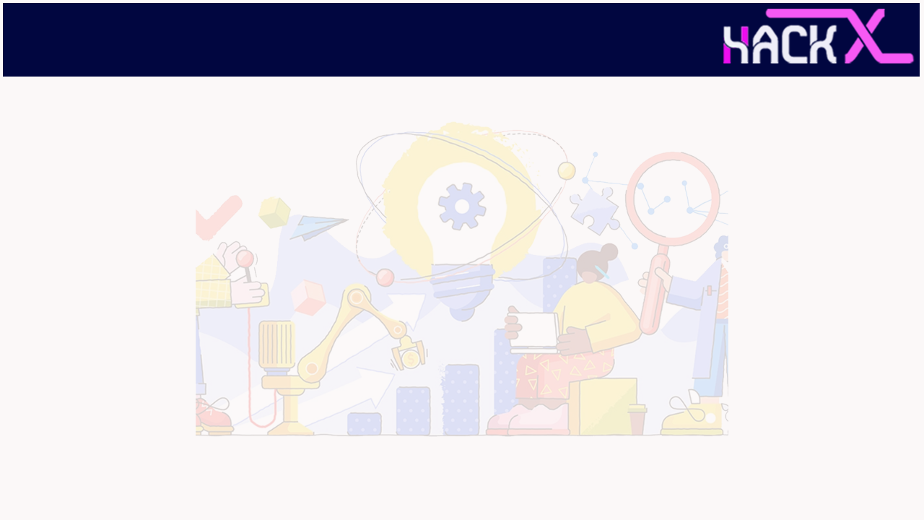
SLIDE 1
1. Team Name: Break it or make it
2. Members:
(Lead) Nitanshu Lokhande 8871719893
Darshan Hande 7021215104
Keshav Agarwal 9079570260
3. Domain: Innovation
4. Problem Statement: Lack of internet in remote areas

Slide 2
SLIDE 2
Problem:
Poor Internet connectivity due to various reasons can hamper the performance of a potential candidate and ruin their entire hard-work. It also decreases the accuracy of judgement of one's skills and knowledge. Nowadays, during the global pandemic, the educational sector has migrated online and even the exams are being conducted online without considering that not every one can manage to get fast and secured internet connectivity.

Slide 3
SLIDE 3
Idea & USP:
OffQuiz can be considered to be an aid in the age of uncertain internet connectivity. OffQuiz is a competent assessment platform which provides an secure offline environment to conduct multiple choice type quizzes.
Teacher can use the web portal to form batches of students.
Quiz can be created on the web portal by the teacher.
All the created quizzes can be viewed on the dashboard.
Once the quiz is created the teacher can circulate the quiz within an already created batch of students.
At the students end, all you require is a smartphone with incoming sms facility.
Students receive a encrypted message on their phone which the OffQuiz App decrypts and display the Quiz on screen.
INTERNET CONNECTION IS NOT REQUIRED AT THE STUDENTS' END TO ATTEMPT THE QUIZ.
The Quiz Responses are encrypted and sent to our servers through sms.

Slide 4
SLIDE 4
Frontend
Reactjs, CSS with Sass, Semantic UI library
Backend
Nodejs, Expressjs
Mobile Application
Flutter, Dart
Database
Firestore, Firebase

Slide 5
SLIDE 5
IMPLEMENTATION
First of all teacher need to create account on our website. We will be storing teacher credentials(email, password) in firebase. After creating account teacher can create batches(a batch is basically a group of students of same class where teacher can circulate quiz) when a batch is created then a unique link will be generated which teacher needs to circulate among students of that particular batch to get their mobile number, we will store these mobile numbers in our database so that we can use these numbers to send quiz on student mobile via sms. and after creating batch teacher will create quiz for the students where teacher needs to provide all details like quiz date,quiz start time, quiz end time, teacher mobile number on which he/she wants to get response back from the students and obviously question & options. Now when teacher will click on circulate quiz button then first of all we will encrypt all of the questions and options of that quiz using our self made algorithm then we will compress this encrypted text using LZ string method to give a second layer of security to the quiz and then with the help of twilio api we will send this encrypted and compressed text on student phone via message. From student end we are fetching all these message using our app and decrypting this text and showing all the quizzes on app dashboard. Student can’t open quiz which already finished or not started yet(we will be comparing current time with quiz start and end time to decide whether a quiz is started, finished or not started yet). When quiz will start student can open that quiz, a timer will also be start so if student submit that quiz or timer will end in both the cases we will close that quiz window and send user response to teacher via sms.

Slide 6
SLIDE 6
BUSINESS SCOPE
Solution need implementation of two software components webapp and mobile application.
Cost of sending SMS through web will be minimal on using twilio sms api.
Mobile Application will be economical at student end as student don’t need internet while attempting quiz.
Can be easily scaled.
Less maintenance cost of application as application will be offline and in no way connected with internet.
Due to covid pandemic situation the customer acquisition cost is lower as institute need an offline alternative to conduct exams due to lack of stable internet at student end.

Slide 7
USP (unique selling points)
Teacher can use the web portal to form batches of students.
Quiz can be created on the web portal by the teacher.
All the created quizzes can be viewed on the dashboard.
Once the quiz is created the teacher can circulate the quiz within an already created batch of students.
At the students end, all you require is a smartphone with incoming sms facility.
Students receive a encrypted message on their phone which the OffQuiz App decrypts and display the Quiz on screen.
INTERNET CONNECTION IS NOT REQUIRED AT THE STUDENTS' END TO ATTEMPT THE QUIZ.
The Quiz Responses are encrypted and sent to our servers through sms.

Slide 8
Thank You

